Slide 1

H-1B VISA ANALYSIS

Slide 2

OVERVIEW
The H-1B visa program has been a significant part of the US labor market, providing temporary employment opportunities for foreign workers in specialized fields. There is fluctuation in the visa application programs and also there has been an existing issue in the US labor market and economy as a whole. Based on the situation our analyses will aim to,
Identify the key trends and patterns in H-1B visa usage,
Examine the characteristics of H-1B visa holders
Evaluate the program's impact on wages, job opportunities, and economic growth

Slide 3

INTENDED AUDIENCE
1. H-1B visa applicant 2. Government officials 3. Human resources professionals 4. Business leaders 5. Researchers and analysts

Slide 4
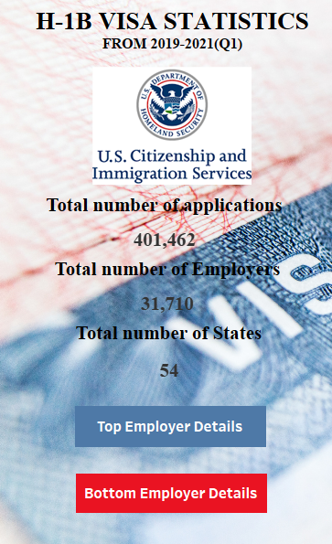
H-1B VISA STATISTICS

Slide 5
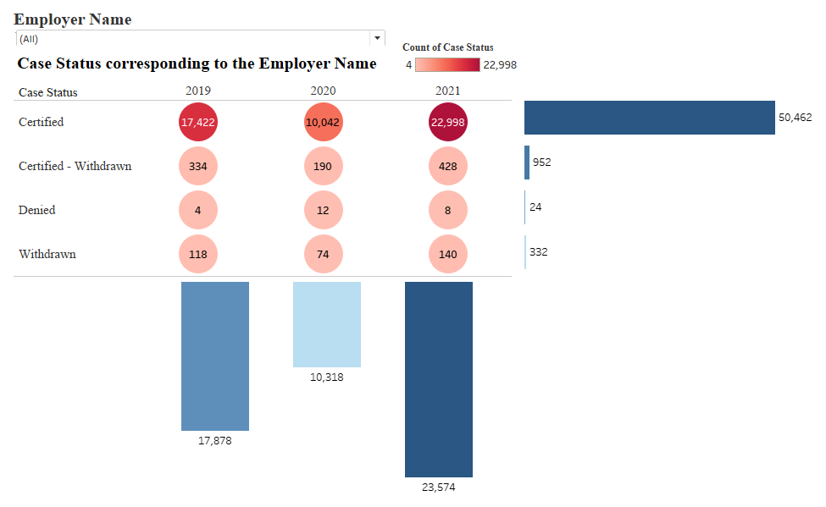
CASE STATUS We analyzed the data based on case status and decision date from 2019-2021. From our analysis, the certified, certified-withdrawn, and withdrawn have been increased. The denial rate has sharply decreased. This proves that there is an increase in opportunities for H-1B applicants. This visualizes the total number of applications year-wise and the total of case status for 3 consecutive years.

Slide 6
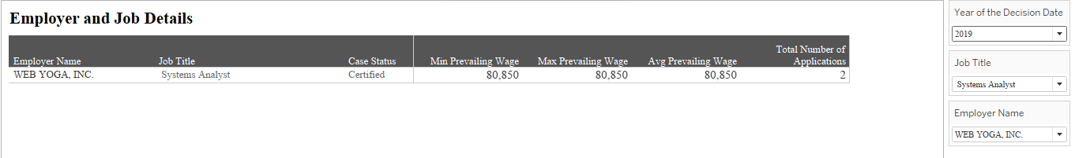
EMPLOYER AND JOB DETAILS
By filtering the Employer name and Job title we will be able to know the aggregations of prevailing wage also the count of applications filed by the Employer.

Slide 7
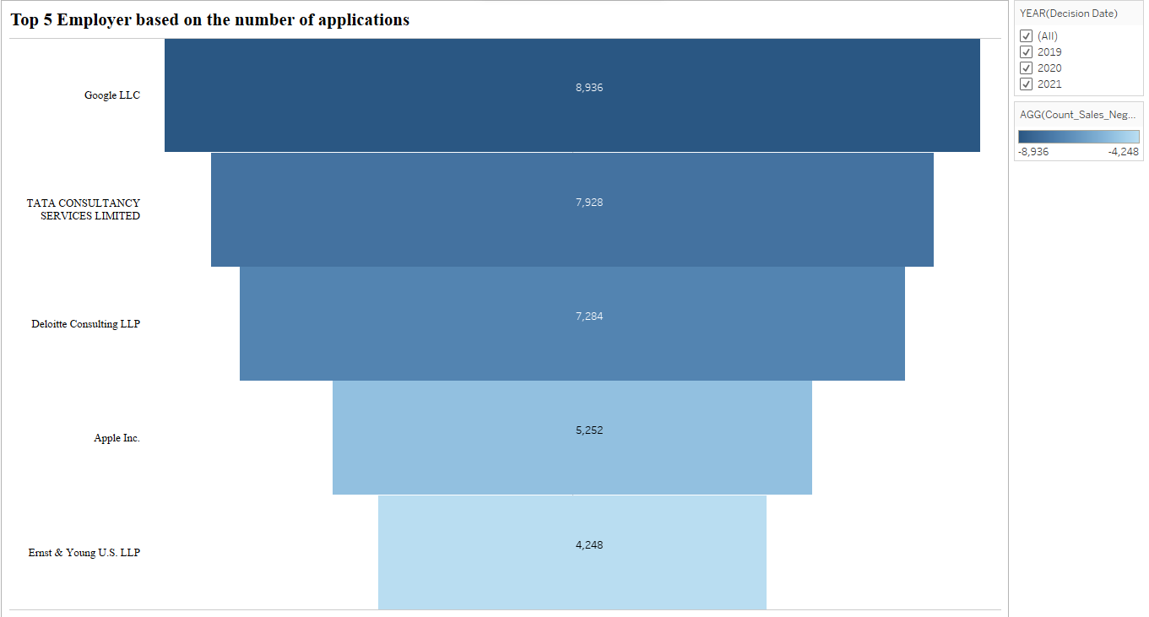
TOP 5 EMPLOYERS BASED ON APPLICATION

Slide 8
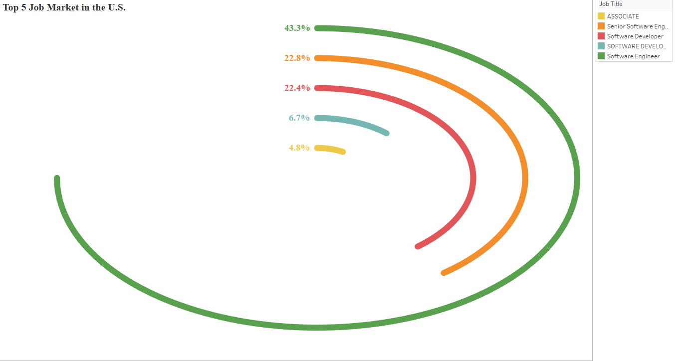
TOP 5 JOB MARKETS IN THE U.S.

Slide 9
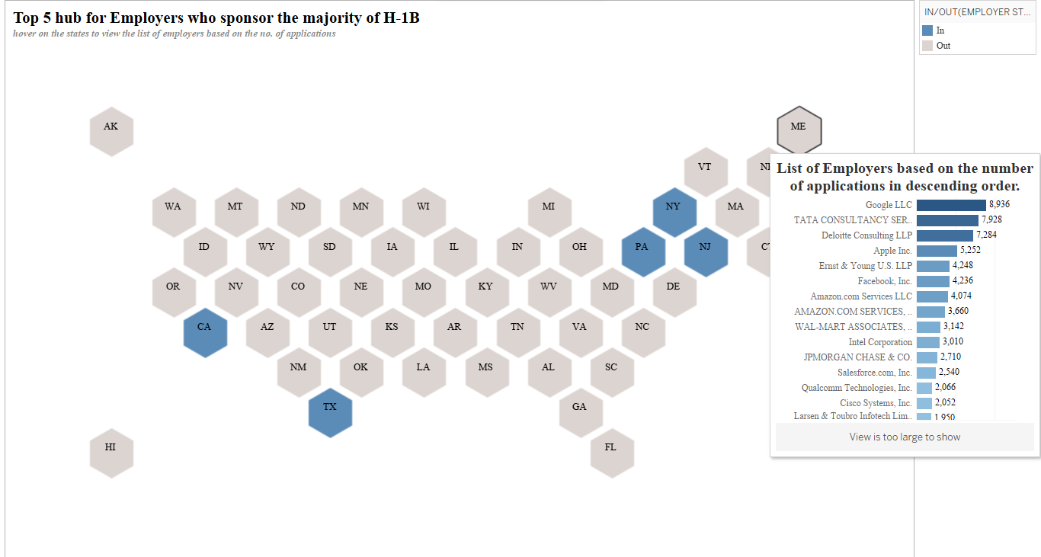
TOP 5 HUB FOR EMPLOYERS WHO SPONSOR THE MAJORITY OF H-1B
For further checking of Company details based on the count application, we can hover on a distinct state to view the details.

Slide 10
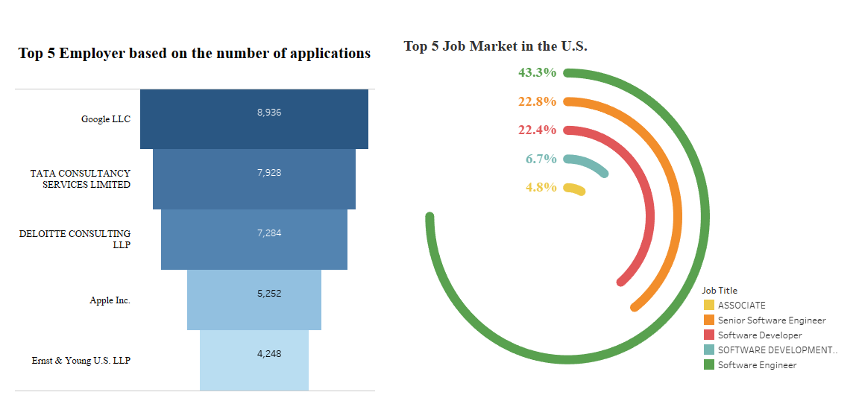

Slide 11
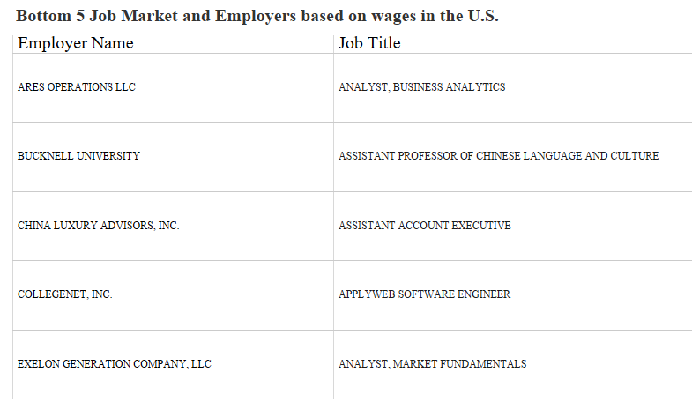
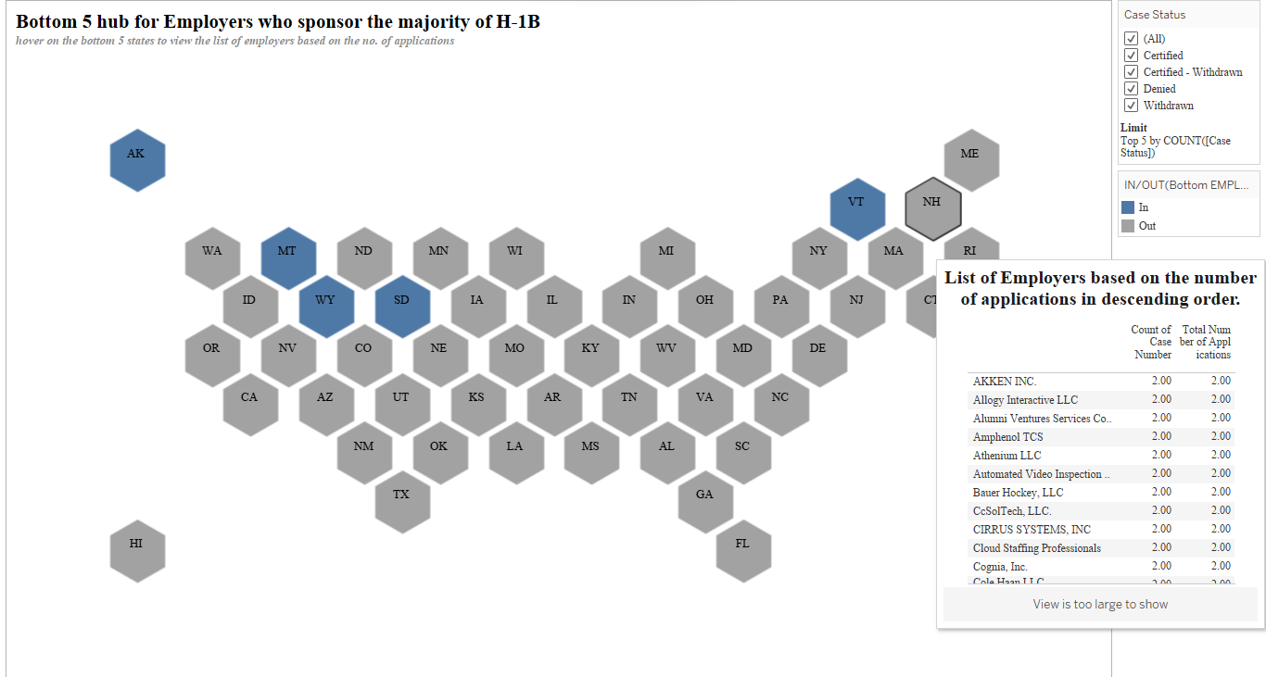
BOTTOM EMPLOYER DETAILS
Analyst, Business Analyst seems to be the lowest Job title on the list and the company corresponding to it is Ares Operation LLC. The lowest 5 states in the US with the certified approval rate are Alaska, Montana, Vermont, South Dakota, and Wyoming.

Slide 12
CONCLUSION
By analyzing and visualizing data on H-1B visa applications and approvals, an individual can identify which states and areas are likely to be hubs for H-1B employers and sponsors, which industries are sponsoring the most H-1B visas, the U.S. job market fluctuation, and their wages. This information can be valuable for Government officials, employers, and foreign workers interested in understanding the dynamics of the H-1B visa program and using this data for analyses. Overall, Tableau can help provide a more comprehensive understanding of the H-1B visa program and its impact on the US economy and workforce.

Slide 13
REFERENCE LINKS
To view more info about H-1B visa(Official Site) - https://www.uscis.gov/working-in-the-united-states/h-1b-specialty-occupations
https://travel.state.gov/content/travel/en/us-visas/immigrate.html
Data Source - https://www.dol.gov/agencies/eta/foreign-labor/performance
To Calculate the Current vs New Prevailing Wage - https://travel.state.gov/content/travel/en/us-visas.html/

Slide 14

THANK YOU

